Slide 1
CSC434 Group Project
Ryan Burchette, Madeline Blackwell, Nicholas Hudler, Kamron Sigmon
https://github.com/angryparzival/CSC434GroupProj

Slide 2
Objectives
Understand encryption algorithms through experimentation and how decryption tools crack it
Successfully identify and confirm packed malware using PEiD to learn of another way malware can be hidden
Learn how to use debuggers to understand the assembly code of malware once we identify the malware
Tools
Cryptool
x64dbg
PEiD

Slide 3
Understanding Encryption Algorithm Through Experimentation and How Decryption Tools Crack it
By: Everyone

Slide 4
Background Knowledge
Rijndael, or Advanced Encryption Standard (AES), is a form of symmetric encryption that uses fixed length blocks of data and various key lengths, combined with repeated mathematical algorithms to transform the data. The data undergoes various stages of substitution and permutation to ensure it is near impossible to decrypt the data without the appropriate key. They tool of choice to demonstrate this encryption algorithm is Cryptool. Cryptool is an open-source software that shows the different steps of an encryption algorithm using its GUI. This can be very beneficial in an educational environment to learn how each step transforms the data.

Slide 5
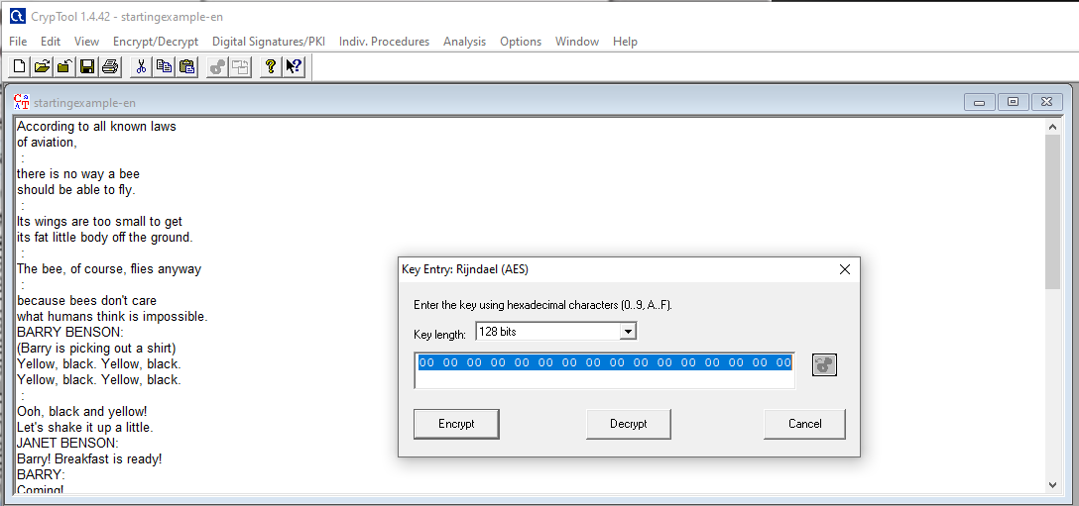
Step 1: Encrypting the Message
The plaintext is displayed along with the key Entry: AES box.
The key length is 128 bits.

Slide 6
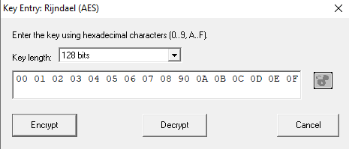
Step 2:
The Key Entry: AES is enlarged to show the key entered in.
The key is entered in here using hexadecimal characters.

Slide 7
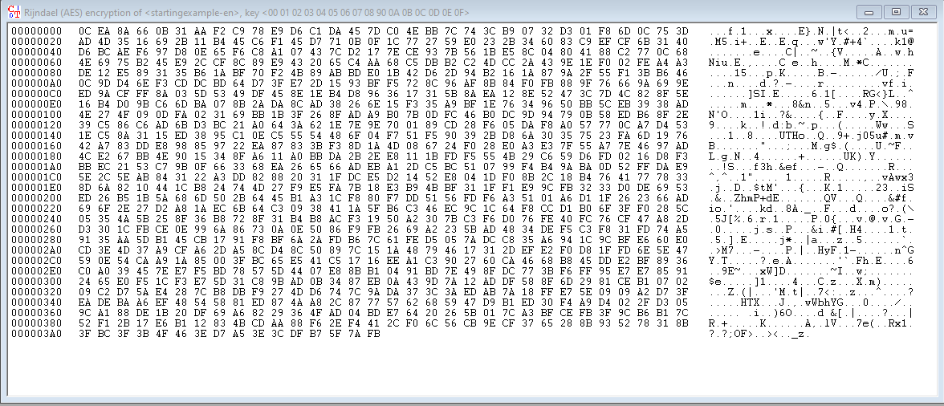
Step 3:
The output when you run the AES encryption.
In the middle is the ciphertext in the form of hexadecimal.
On the far right is the ciphertext in ASCII form.
The dots mean that the hexadecimal equivalent does not have a form in ASCII.

Slide 8
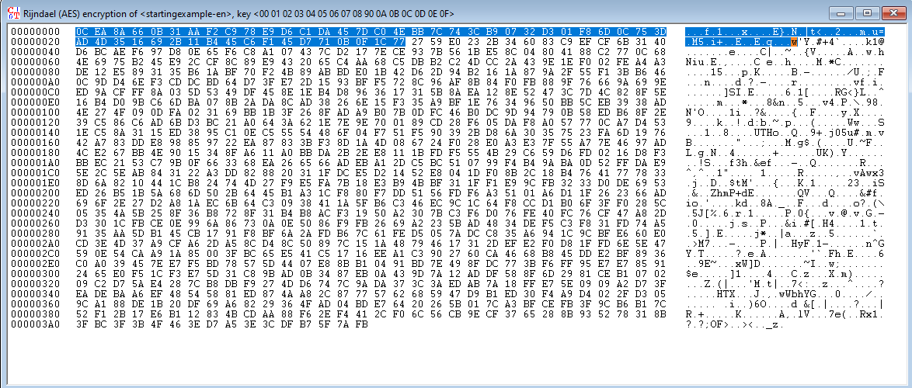
Step 4:
The highlighted cipher text in the visual form is equivalent to the highlighted text in hexadecimal.

Slide 9
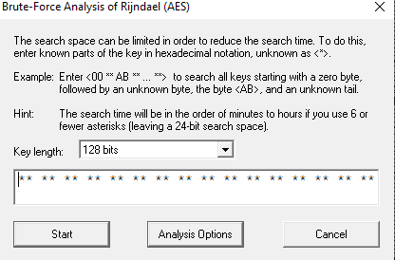
Step 5: Decrypting the Message
This is the popup when you want to run AES decryption. This would require knowing that the ciphertext is in AES form.
You can input a key or attempt to run it without knowing any part of the key.

Slide 10
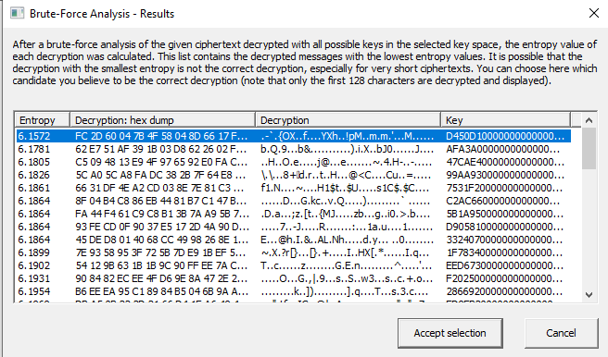
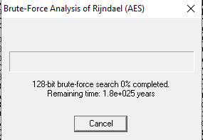
Step 6:
If you attempt to run the brute force attack without any key, the time to crack would be impossibly long.
When letting it run for a few seconds, the output (image on the right) shows that it came nowhere close to getting the correct key or plaintext.

Slide 11
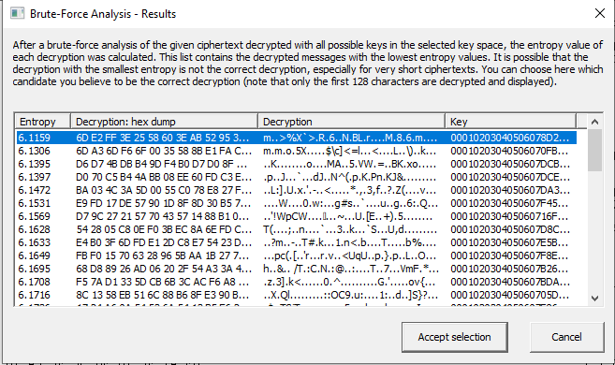
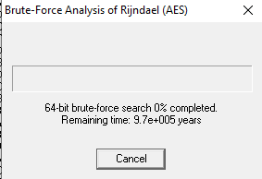
Step 7:
Even if you know half the key through some cracking method, it will still take 85,000 years to crack.
But you can see on the left that a few seconds did come back with much better results in terms of the plaintext (“Decryption” section in the middle column on the right side.

Slide 12
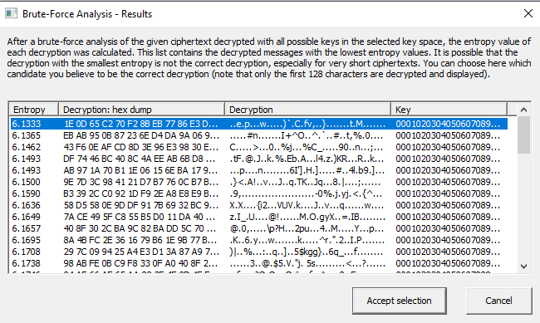
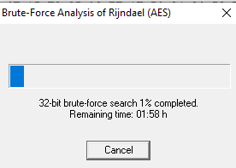
Step 8:
If you somehow manage to know ⅔ of the key you could crack the cipher in 2 hours.
The more you know of the key the quicker it is to decrypt.

Slide 13
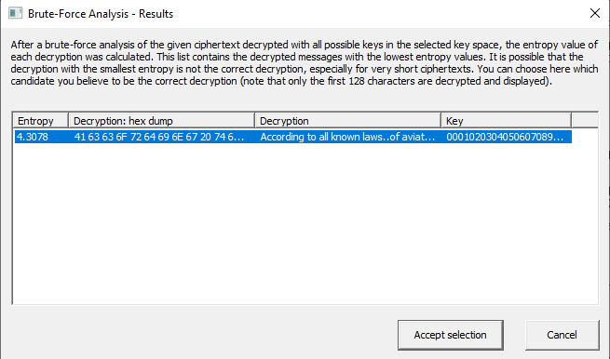
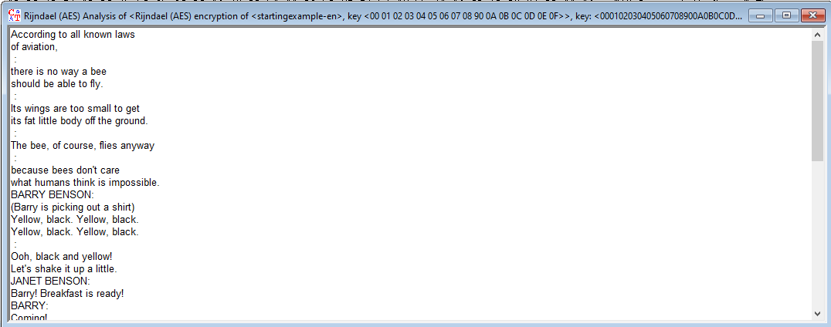
Step 9:
If you know the complete key though, the decryption occurs within milliseconds.
If you look at the decryption section you can see it looks right and for extra proof the image on the right is the decrypted ciphertext.

Slide 14
Successfully Identifying and Confirming Packed Malware Using PEiD
Done By: Ryan Burchette and Madeline Blackwell

Slide 15
Background Knowledge
PEiD is a scanner to check for packed files. Packed files means to compress the files in a way that will help avoid detections by antiviruses. It does this through changing the types of signatures like hashes. The PEiD can check for over 470 different signatures in PE files.
Tools:
PEiD
Github of packed files
Notes:
-understanding malware and recognizing malware
- understanding packing techniques- common packing techniques such as UPX
- Experience with assembly language
- knowledge of hashing
- Know how to use Peid and interpret output

Slide 16
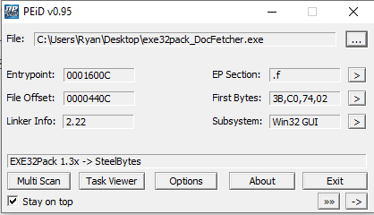
Selecting and Running .Exe File
This is the information that will popup when a file is selected in PEid
There are many options you can do from here such as unpacking or viewing other info
On the next slide we will discuss the important things on this popup

Slide 17
Analyzing Results Part 1
The first thing and the most important thing we should look at is this line
This line confirms that this file is in fact packed
It is packed with EXE32Pack 1.3x

Slide 18
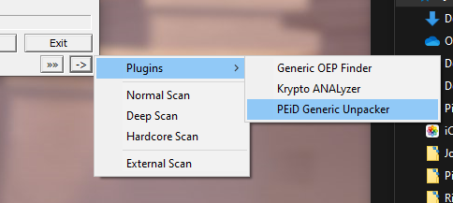
Analyzing Results Part 2
Now that we have confirmed that the file is packed we can use an unpacker
PEid comes with a default one but there are often ones built specifically for the packer

Slide 19
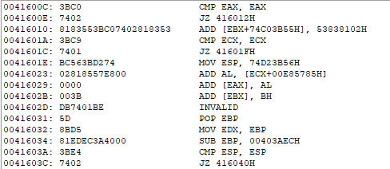
Analyzing Results Part 3
An additional interesting part of PEid is the “First Bytes” section
It is literally the first bytes of the file but if you click the over arrow you will get information on the assembly of the file

Slide 20
Learning How to Use Debuggers to Understand the Assembly Code of Malware
Done By: Nick Hudler and Kamron Sigmon

Slide 21
Background Knowledge
Assembly code is a level of abstraction between machine code and higher-level programming languages. The assembly code of malware is often difficult to understand due to several layers of obfuscation to make it confusing. Tools like x64dbg can be used to determine key function calls within the assembly code. Combined with knowledge of common patterns from other malware’s usage of obfuscation, the behavior of the malware is able to be analyzed to see what data and registries are modified by the malware. x64dbg contains features such as being able to view the assembly code and setting breakpoints to run through each step of the code, with detailed logging of each event. This makes analyzing how malware works significantly easier.
Notes:
Computer architecture knowledge
Operating system knowledge
Programming language knowledge
Be familiar with assembly language
Understand debugging concepts
Know od basic computer security and basics of malware
Become familiar with tools like x64dbg

Slide 22
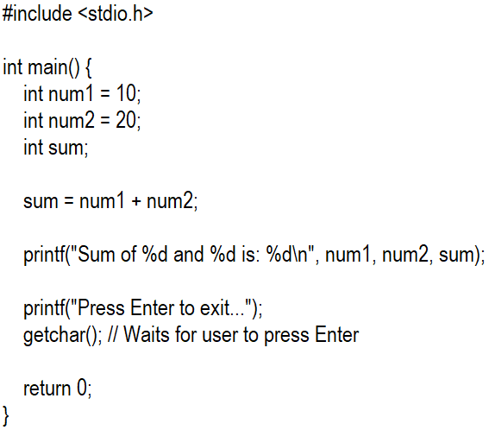
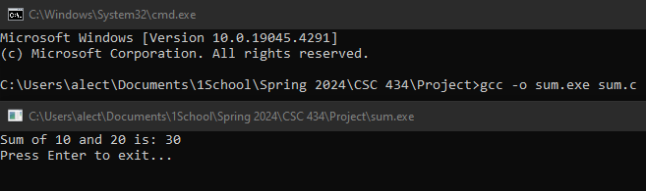
Example Code
Here is the example code that will be used in the tool to demonstrate analyzing malware. I am not going to use actual malware code as I do not want to risk damaging my system, however the functionality is still the same with the tool.

Slide 23
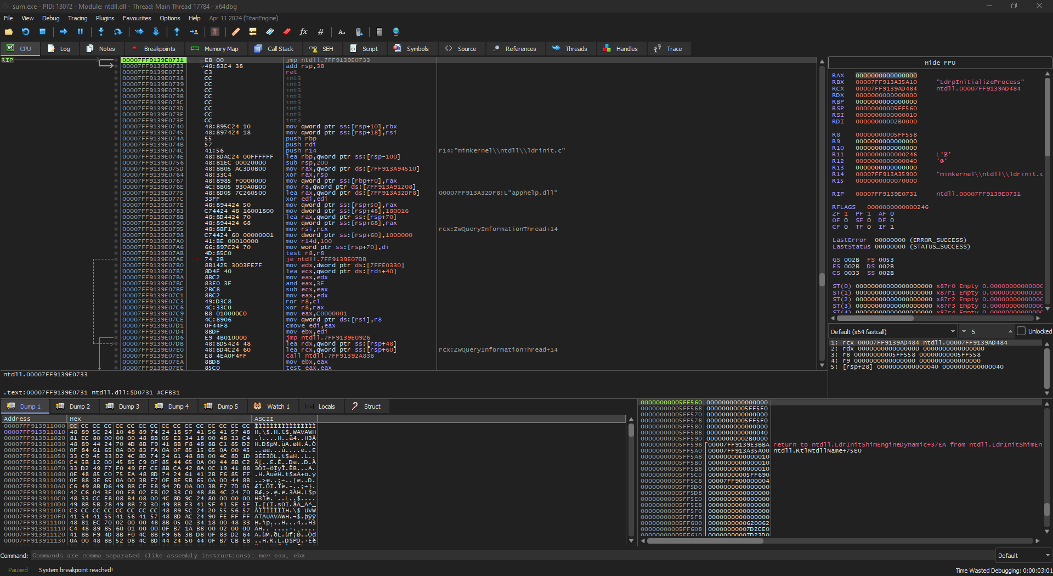
Step 1: Loading the File
This is what the environment of the tool looks like when the intended executable is loaded. The important section is all of the assembly code that is run on execution.

Slide 24
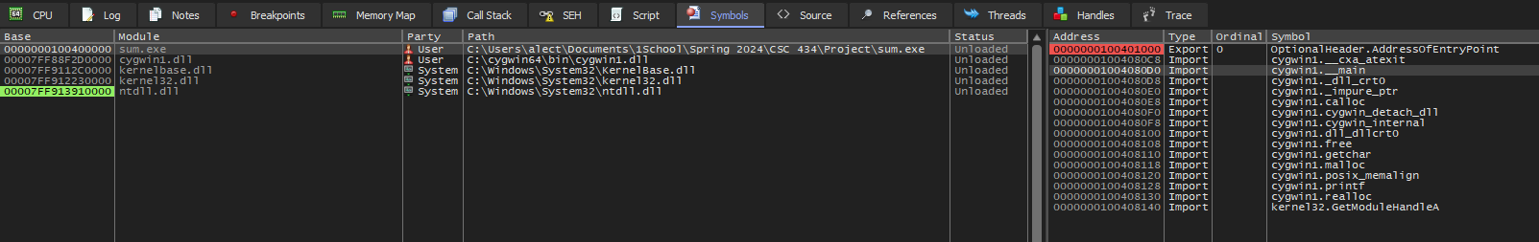
Step 2: Assigning Breakpoints
We want to set a breakpoint at each of the main steps of the program. We can find each function call in the symbols tab for the sum.exe module.
The main, printf, and getchar symbols are where we want to place the breakpoints.

Slide 25
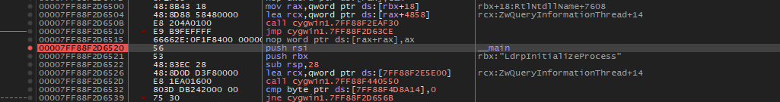


Step 2: Assigning Breakpoints

Slide 26
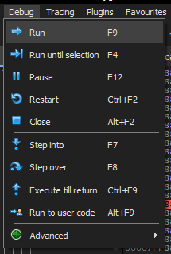
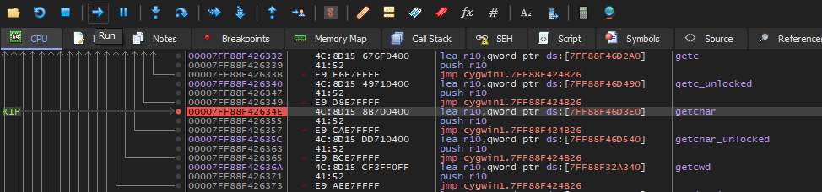
Step 3: Begin Debugging
Using the Run button in the debugging menu, we can go to each breakpoint, and either step into or over the section as desired to view each of the assembly code commands being run to execute the program. At each point, we can view the memory map tab to analyze the address space utilized by the program.

Slide 27
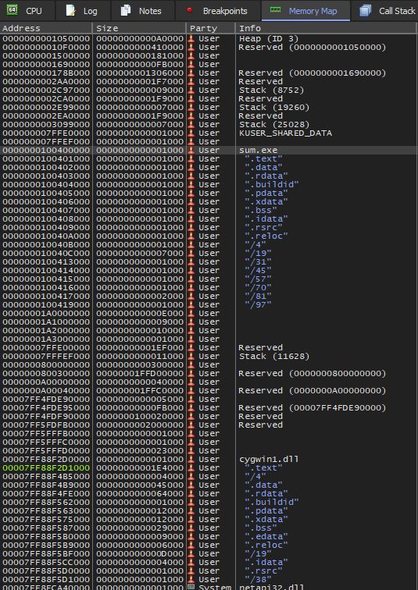
Step 4: Address Space Observations
Throughout the debugging process, we are able to use the Memory Map tab to view the memory addresses, size, and information regarding the program. We can see the changes that occur to the program with this view.

Slide 28
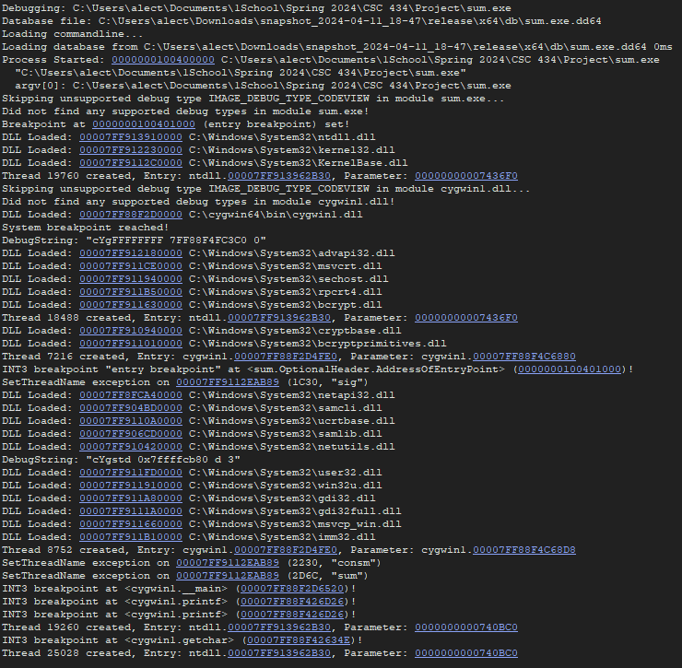
Step 5: Observations from Program Logs
Under the Log tab we can view the logs of each point that a DLL is loaded in order to execute the program using the cygwin library for windows. The logs also indicate when the breakpoints are reached and the string generated in the printf function, resulting in the 3 and 0 to form 30.

Slide 29
Summary

Slide 30
Summary
First we showed the use of the tool Cryptool
We demonstrated encrypting and decrypting and the strength of the AES algorithm
This showed one way that file can be kept safe but also a way malware can be hidden
Next we used the PEid
We demonstrated how to confirm a packed file using the PEid tool
This again showed another way that malware can be hidden within files
After we know how malware is hidden we looked at the assembly code
We demonstrated how to run through the execution of a program and tracking the changes in its address space.
This tool makes analyzing the address space changes and various functions of an executable a simple task.

Slide 31
References

Slide 32
References
PEiD Tutorial
PEiD Info
Cryptool Demo
Cryptool Documentation
x64dbg Tutorial
x64dbg Documentation

